Slide 1
Introduction
Subject - IP addressing

Slide 2
Topics
What is an IP address ?
Types of IP addressing
Classes of IP address
Networks & subnetworks
IP addresses and routing

Slide 3
What is an IP address?
IP (Internet Protocol) address
  device used by routers, to select best path from source to destination, across networks and internetworks
  network layer address, consisting of NETWORK portion, and HOST portion
  logical address,assigned in software by network administrator
  part of a hierarchical ‘numbering scheme’ - unique, for reliable routing
  may be assigned to a host pc, or router port

Slide 4
Types of IP address
Static address
Dynamic address

Slide 5
Types of IP address
Static IP address
  manually input by network administrator
  manageable for small networks
  requires careful checks to avoid duplication

Slide 6
Types of IP address
Dynamic IP address
examples - BOOTP, DHCP
  assigned by server when host boots
  derived automatically from a range of addresses
  duration of ‘lease’ negotiated, then address released back to server

Slide 7
Classes of IP address
Class A - large organizations , governments
Class B - medium sized organizations
Class C - small organizations

Slide 8
Class A IP address
1st octet = network address, octets 2-4 = host address
1st bits of 1st octet set to 0
up to (2^²⁴ - 2) host addresses (16.8M)

Slide 9
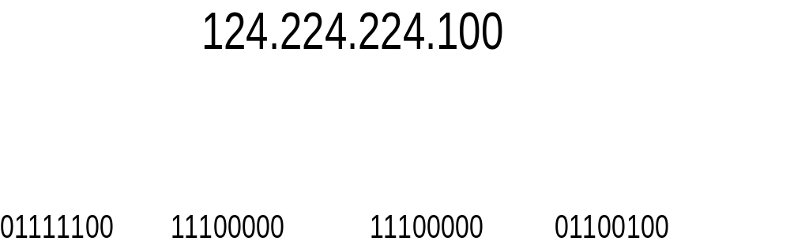
Class A IP address

Slide 10
Class B IP address
1st 2 octets = network address, octets 3-4 = host address
1st 2 bits of 1st octet set to 10
up to (2^¹⁶ - 2) host addresses (65534)

Slide 11
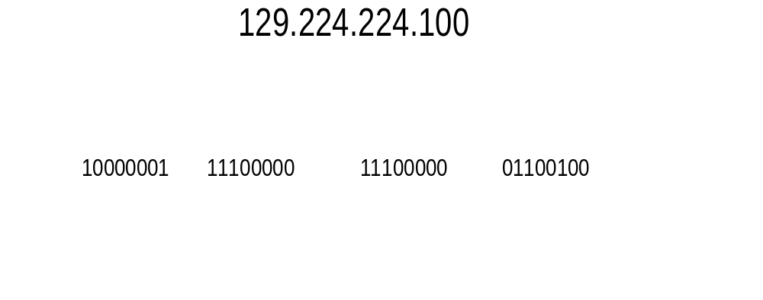
Class B IP address

Slide 12
Class C IP address
1st 3 octets = network address, octet 4 = host address
1st 3 bits of 1st octet set to 110
up to (2^⁸ - 2) host addresses (254)

Slide 13
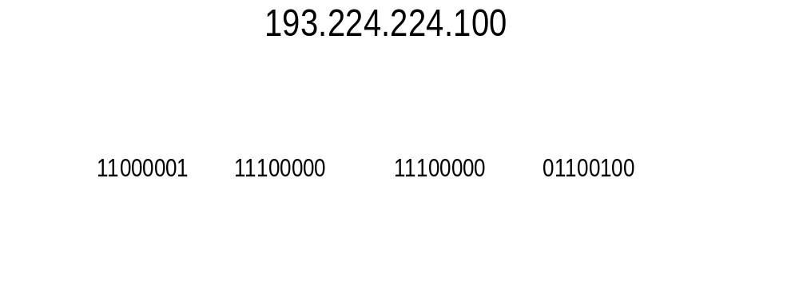
Class C IP address

Slide 14
IP addresses and routing
routing tables
identifying source and destination
IP packet routing

Slide 15
IP addresses and routing -Routing tables
  created by router, held in memory, constantly updated
based on cross-referencing
  IP packet source address, and port on which received

Slide 16
IP addresses and routing Identifying source and destination
  as part of a layer 3 packet, IP header contains source and destination address
  each address is 32 bits long, and unique to device or port
  router reads destination IP address, checks against routing tables

Slide 17
IP addresses and routing - IP packet routing
  if destination address not on the same segment as receive port, router sends packet to correct port for routing to destination
  if destination on same segment as receive port, packet not forwarded

Slide 18
Networks and subnets
why subnet
subnet mask
restrictions on ‘borrowed’ bits

Slide 19
why subnet
  reduce broadcast domain, improve network efficiency

Slide 20
subnet masks
  extend NETWORK portion, borrow from HOST portion
  allow external networks to route packets direct to subnet

Slide 21
restrictions on borrowed bits
reserved addresses
  all 0’s= network address, all 1’s broadcast address
minimum of 2 bits borrowed from host portion
minimum of 2 bits left for host portion

